Slide 1
Communicating Methods, Results, and Intentions in Empirical Research
Jessica Hullman
Assistant Professor University of Washington
steveh.co/panel

Slide 2
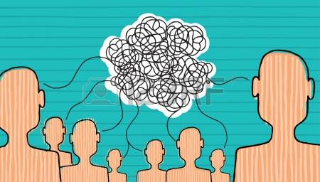
Research as a conversation
Developing good communication habits is critical to success.
WITH EACH OTHER
WITH OURSELVES
steveh.co/panel
Notes:
--If we think about pipeilne – from initial research to define question, to communicating our results, to years after we published a finding …
--Develop good communication habits - Communicating methods, results, intentions

Slide 3
COMMUNICATING METHODS
steveh.co/panel

Slide 4
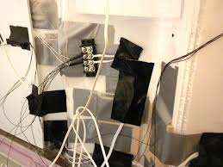
What analysis details are critical to provide?
Explain your experiment design using standard terms before getting into details
Why did you choose this statistical test? If other reasonable alternatives exist, do they produce congruent results?
Submit, and expect to receive, supplemental material
Reviewers should be able to take the study themselves
Videos are useful for empirical papers!
steveh.co/panel

Slide 5
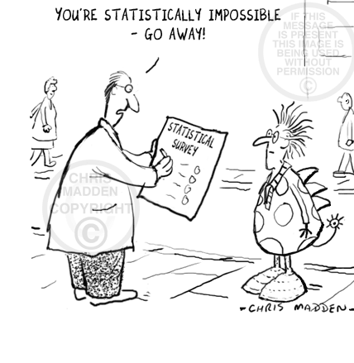
Should we require sample size rationale?
How did you decide the sample size?
Could my study detect an effect of a given size if one did exist?
Pilot, estimate variance, simulate with different Ns
steveh.co/panel
Notes:
Concisely describing an experiment can be difficult.

Slide 6
COMMUNICATING RESULTS
steveh.co/panel

Slide 7
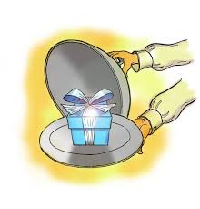
How to deal with surprises in analysis?
If you didn’t have a hypothesis, be wary of drawing conclusions (and avoid testing everything)
Don’t attribute causality to only part of a treatment
Use priors, if only informally
A test with a low error rate can have a high rate of false positives conditional on a positive finding
Robustness checks
Confirm randomization, analyze with and without outliers, assumptions
steveh.co/panel
Notes:
Doing all possible pairwise comparisons is rarely necessary
If you didn’t set out to explain / identify the mechanism, beware of posthoc speculation on what mechanism produced your results
Don’t just trust the result because you chose a low alpha – expectations still matter, even if you don’t want to go all the way with Bayesian analysis
SAFER TO AVOID OVERFITTING THAN TO DO IT, BC EVEN IF YOU ARE CLEAR ON WHATS SPECULATION, OTHERS MAY NOT BE
Particularly about causation -- Inferring causation generally requires hypothesis testing (
Conversely, you might find that there’s an effect where you wouldn’t have expected one. Particularly when using frequentist methods
In the context of probability mathematics, textbooks carefully explain that p(A|B) != p(B|A), and how a test with a low error rate can have a high rate of errors conditional on a positive finding, if the underlying rate of positives is low, but the textbooks typically confine this problem to the probability chapters and don’t explain its relevance to accept/reject decisions in statistical hypothesis testing.

Slide 8
NHST alternatives: Are 95% CIs the answer?
Communicate effect size + uncertainty, but beware of misinterpretation.
Evidence that even researchers using CIs regularly struggle with their interpretation (Belia et al. 2005, Hoekstra et al. 2014)
Confidence intervals …
State confidence in the algorithm
Indicate no relationship between sample variance and bias
Have a direct relationship with conventional hypothesis testing (⍺=0.05) when 95% CIs are used.
steveh.co/panel
Notes:
Pierre’s talk
: CIs are as unintuitive and misunderstand as NHST
95 % confidence is a confidence that in the long-run 95% of the CIs will include the population mean.

Slide 9
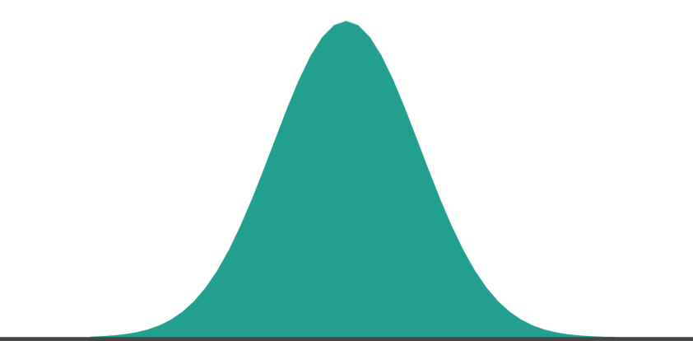
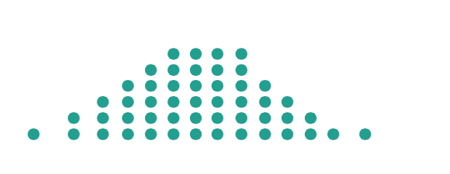
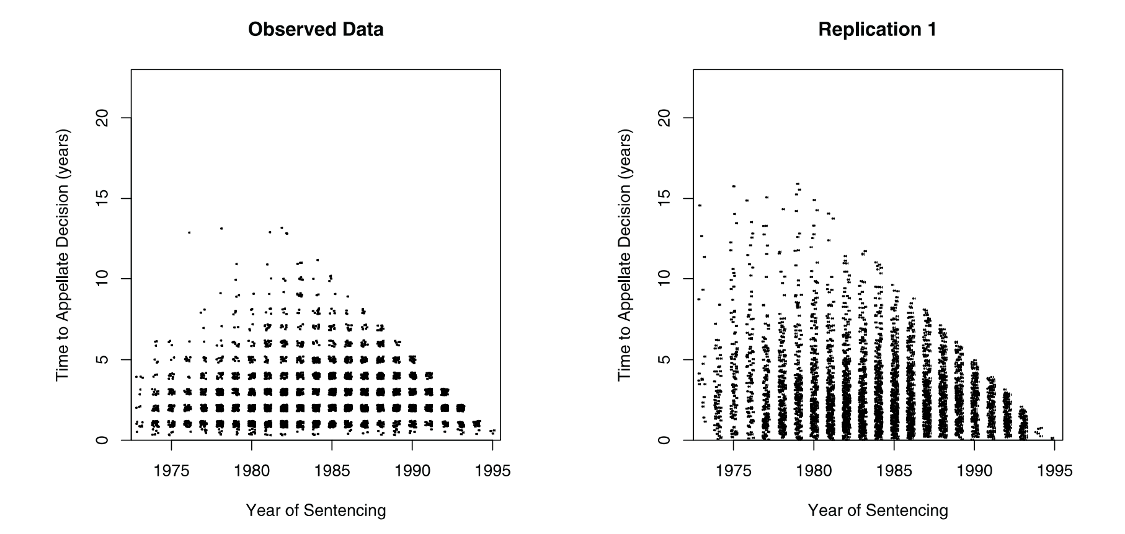
How can I make uncertainty in results concrete?
Present and walk reader through realizations
Posterior predictive checks
Use inferred model to simulate input data, compare to observed
Plot observed + simulated
Plot observed - simulated
We need more research on visualizing experiment results!
Hullman et al. 2015
Kay et al. 2016
steveh.co/panel
Gelman 2004

Slide 10
COMMUNICATING INTENTIONS
steveh.co/panel
Notes:
Develop good communication habits - Communicating methods, results, intentions
Empirical research is a conversation. Groups of researchers across disciplines and subfields draw on one another’s results (e.g., InfoVis and perceptual psychology), researchers interpret and publish their findings for discussion and iteration by others in their field, and each individual researcher must communicate honestly with him or herself to avoid to biasing empirical work toward desired, but not necessarily supported, conclusions. When communication around empirical research is not clear at any of these levels, evaluations of that work, and the subsequent research that builds on those findings, can be subject to false and/or superficial interpretations that threaten the validity of knowledge. I will describe communication challenges spanning different levels of the "research conversation" around empirical work in InfoVis. For example, researchers may overlook the uncertainty or ambiguity in the findings of prior work that they use to motivate their own hypotheses; reviewers may not thoroughly understand a reported experimental design, leading them to accept claims based on overinterpreted evidence; or researchers may fail to acknowledge the degree to which analysis procedures are constructed ad-hoc in an effort to confirm their hypothesis. I will offer ideas for discussion around how revising practices at different points in the pipeline of empirical research—from formulation of hypotheses, to consulting of the literature, to experimental design, to analysis and presentation of results, to review by the community—can help enforce clear communication.

Slide 11
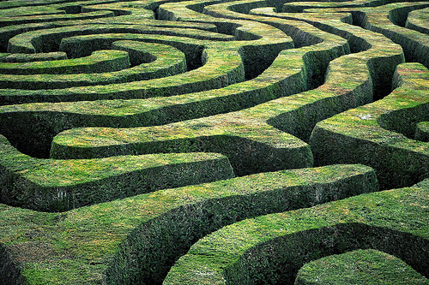
Am I really susceptible to my own biases?
Garden of forking paths / Researcher degrees-of-freedom:
Outlier removal
Which DV matters
Defining comparisons
Whether to transform variables
Which test
When to stop data collection
steveh.co/panel
Notes:
Compare control and all
Compare control and the best two …

Slide 12
Should we pre-specify (pre-register) all studies?
Specify all decisions about data collection and analysis before doing the study (publicly)
Easy version: Implement in your lab by having students write out analysis plans.
You
Your lab
Pre-registration
steveh.co/panel

Slide 13
Thanks!
@jessicahullman
faculty.washington.edu/jhullman
steveh.co/panel

